Slide 1
SpringBoot project with Vue.js
Meeting 4

Slide 2
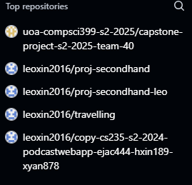
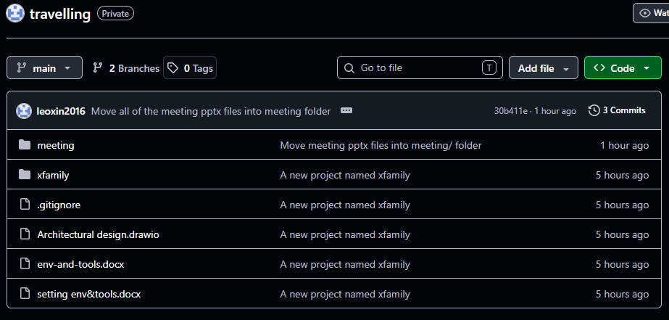

Environment and tools
GitHub tool
Maven Tool Version: 3.9.16
Java Environment Version: 21.0.9

Slide 3
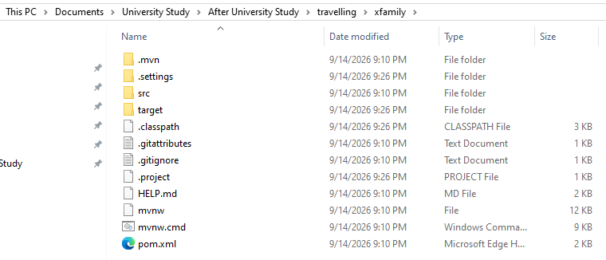

pom.xml: Maven 项目的核心配置文件

Slide 4
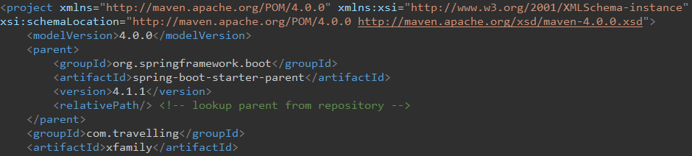
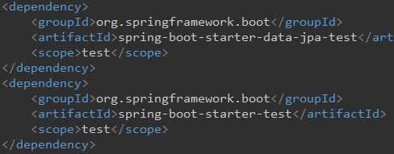
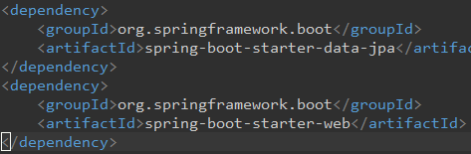
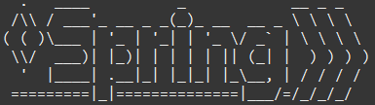



Initialize a SpringBoot project Successfully
4.1.1 version
pom.xml

Slide 5
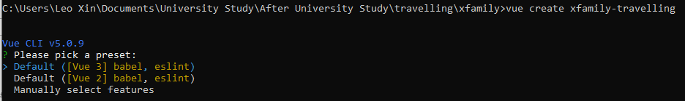
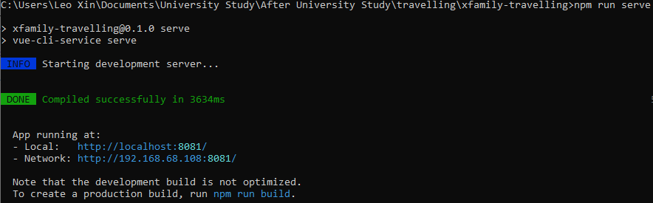
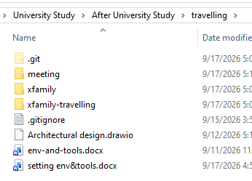

Vue.js: Frontend of the project
建立前端文件夹
前端采用8081端口，与后端分开
前后端分离

Slide 6
Database design (on textbook)

Slide 7
Next Step
Update table design according to discussion.
Create tables in Eclipse (Refer to Capstone Project).

